Slide 1
An Online Learning Approach to Generative Adversarial Networks: A Case Study
Andrew Floyd

Slide 2
Outline
Generative Adversarial Networks (GAN) Background
Paper Goals
Online Learning
Zero-sum Games
CHEKHOV GAN Algorithm
Experimental Results
Image Modeling

Slide 3
Generative Adversarial Networks (GAN)
Generative describes a class of statistical models that contrasts with discriminative models
Generative models can generate new data instances (ex: new animal photos)
Discriminative models discriminate between different kinds of data instances (ex: dog from a cat)
A recent trend in generative models is to use a deep neural network as a generator
Notable approaches include variational autoencoders (VAE) (Kingma and Welling (2013)[1] and Rezende et al. (2014)[2]) and Generative Adversarial Networks (GAN) (Goodfellow et al. (2014)[3])
GAN’s typically have two parts:
The generator that learns to generate plausible data. These instances become negative training examples for the discriminator
And the discriminator that learns to distinguish the generator’s fake data from the real data. It then penalizes the generator for producing the implausible results
At the start of the training, the generator produces obviously inaccurate data while the discriminator quickly learns to identify that it is fake/inaccurate
Notes:
A generative model could generate new photos of animals that look like real animals, while a discriminative model could tell a dog from a cat. Generative models capture the joint probability p(X, Y), or just p(X) if there are no labels. Discriminative models capture the conditional probability p(Y | X). GANs are just one kind of generative model. NN: Such systems "learn" to perform tasks by considering examples, generally without being programmed with task-specific rules

Slide 4
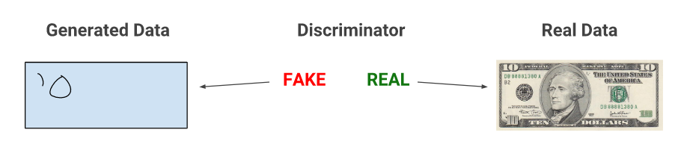
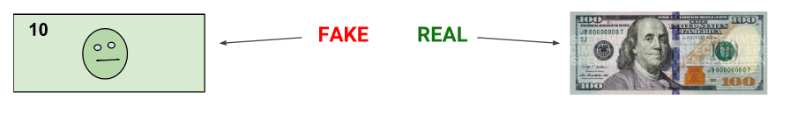
Generative Adversarial Networks (GAN)
Notes:
As training progresses, the generator gets closer to producing output that can fool the discriminator.

Slide 5
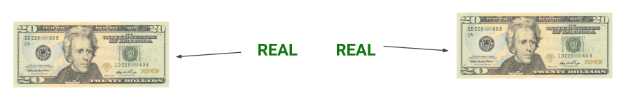
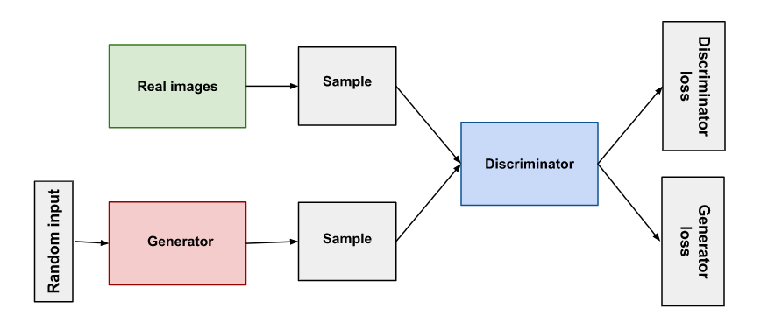
Generative Adversarial Networks (GAN)
As the generator training does better, the discriminator gets worse at telling the difference between real and fake data. Essentially, it starts to classify fake data as real, thus making its accuracy decrease
Notes:
Both the generator and the discriminator are neural networks. The generator output is connected directly to the discriminator input. Through backpropagation, the discriminators classification provides a signal that the generator uses to update its weights.

Slide 6


Generative Adversarial Networks (GAN)
This creates an adversarial game setting where the generator is pitted against the discriminator
Data distribution: p_{data}(x), Model distribution: p_{u}(x)
Probabilistic discriminator: ; Generator:
Each of the two players (generator/discriminator) tries to optimize their own objective, which is exactly balanced by the loss of the other player, thus yielding a two-player zero-sum minimax game
Typical GAN approaches aim at finding a pure Nash Equilibrium by using traditional gradient-based techniques to minimize each player’s cost in an alternating fashion
But an update made by one player can repeatedly undo the progress made by the other one, without ever converging
Thus, alternating gradient descent fails to converge even for very simple games. This is one of the central issues for GAN’s, which in practice leads to oscillations between different kinds of generated samples
Notes:
In general, alternating gradient descent fails to converge even for very simple games Salimans et al. (2016). In the setting of GANs, one of the central open issues is this non-convergence problem, which in practice leads to oscillations between different kinds of generated samples Metz et al. (2016).

Slide 7
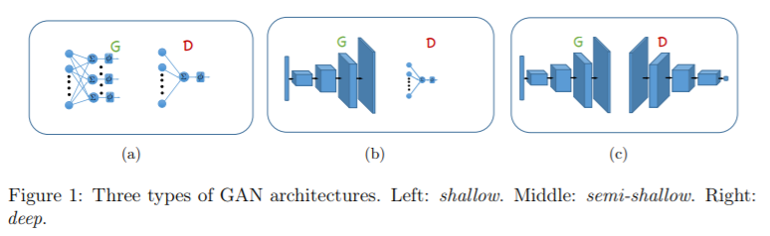
Improving on GANs?
Standard GAN methods seek to find pure minimax strategies, here we consider mixed strategies, which allows the use of online learning algorithms for mixed strategies in large games
The most elementary architectures are shallow ones
Consists of a single layer network as a discriminator, and a generator with one hidden layer
A powerful generator is needed to model complex data distributions
In this paper we look at semi-shallow architectures where the generator is any arbitrary network
1) Can we efficiently find an equilibrium for semi-shallow GAN architectures?
2) Can we extend this result to more complex architectures?
Notes:
Pure: Each player would like to choose his strategy to guarantee himself the best possible payoff, regardless of what his opponent does. Mixed: a probability distribution on a player’s set of choices, according to which the player makes his choice, randomly and independently of the other players choice. Hidden layer: Each layer can apply any function you want to the previous layer (usually a linear transformation followed by a squashing nonlinearity).
The hidden layers' job is to transform the inputs into something that the output layer can use.
The output layer transforms the hidden layer activations into whatever scale you wanted your output to be on

Slide 8
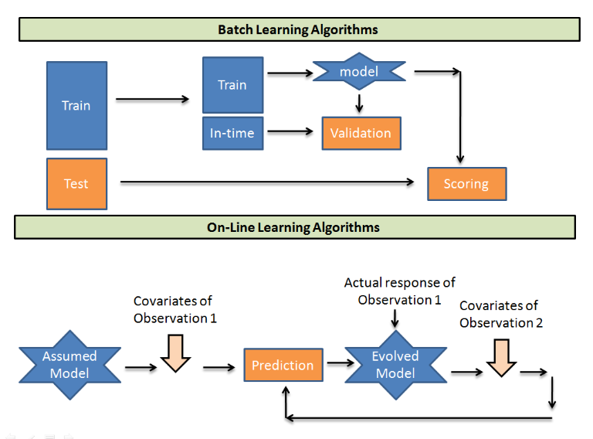
Online Learning
Notes:
Batch learning algorithms take batches of training data to train a model. Then predicts the test sample using the found relationship. Whereas, On-line learning algorithms take an initial guess model and then picks up one-one observation from the training population and recalibrates the weights on each input parameter. Computationally much faster and more space efficient, Usually easier to implement, More difficult to evaluate online, More difficult to maintain in production

Slide 9

Online Learning
A sequential, decision-making framework in which a player aims at minimizing a cumulative loss function revealed to him sequentially
The source of the loss functions may be arbitrary or even adversarial, and the player seeks to provide worst case guarantees on his performance
Formally, a repeated game of T rounds between a player P1 and a adversary P2. At each round t:
1. P1 chooses a point u_{t} in K, according to some algorithm A (decision set K is assumed to be convex)
2. P2 chooses a loss function f_{t} in F (F is a structured class of objectives, usually linear/convex losses)
3. P1 suffers a loss f_{t}(u_{t}) and the loss function is revealed to himself
The performance of the player’s strategy is usually measured by regret, defined as:

Slide 10

Online Learning
Regret measures the cumulative loss of the player compared to the loss of the best fixed decision in hindsight
Players aim at minimizing their regret, hence we are interesting in no-regret strategies in which players ensure an o(T) regret for any loss sequence
Many of the no-regret strategies are often forms of the Follow-the-Regularized Leader (FTRL) algorithm:
FTRL takes the accumulated loss, observed up to time t, and then chooses the point in K that minimized this loss, plus a regularization term (this prevents the player from quickly changing decisions between consecutive rounds)
FTRL is not always guaranteed to yield no-regret
Notes:
Note that FTRL is not always guaranteed to yield no-regret, and is mainly known to provide such guarantees in the setting where losses are linear/convex

Slide 11
Zero-sum Games
Consider two players, P1 and P2, who can choose pure decisions among continuous sets K₁ and K₂ respectively
Upon choosing a pure strategy (u,v) in K₁ x K₂ , the utility of P1 is -M(u,v), while the utility of P2 is M(u,v). The goal of both is maximize their worst cast utilities
This definition only makes sense if their exists a point at Pure Nash Equilibrium (u*,v*), which satisfies:
While a pure Nash equilibrium does not always exist, there is always a Mixed Nash Equilibrium (MNE), i.e. there always exists two distributions D1 and D2 such that:
Notes:
A zero-sum game is one in which no wealth is created or destroyed. So, in a two-player zero-sum game, whatever one player wins, the other loses. Therefore, the player share no common interests. There are two general types of zero-sum games: those with perfect information and those without. In a game with perfect information, every player knows the results of all previous moves (tic-tac-toe, chess). Imperfect games often involve simultaneous play
A zero-sum game is defined by a function M : K1 × K2 → R which sets the utilities of the players.
A mixed strategy Nash equilibrium involves at least one player playing a randomized strategy and no player being able to increase his or her expected payoff by playing an alternate strategy. A Nash equilibrium in which no player randomizes is called a pure strategy Nash equilibrium.

Slide 12

Finding an Equilibrium in GANs
Ultimate goal is to efficiently find an approximate MNE for the game
We can see the benefit of finding an equilibrium instead of purely solving the minimax objective when looking at a simple zero-sum game like rock-paper-scissors, which has the following minimax objective:
Maximum of rows: {1,1,1}; Minimum of that set is 1
Hence, solving for the minimax objective gives a pure strategy with a minimax of 1
The equilibrium strategy of the min player is a uniform distribution over actions, which has a minimax value of 0
Thus finding an equilibrium by allowing mixed strategies implies a typically smaller minimax value

Slide 13
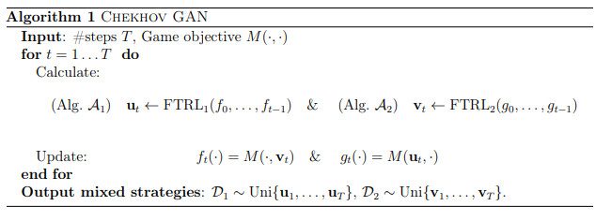


Semi-concave Zero-sum Games
A game (M) is semi-concave if for any fixed u₀ in K₁ the function g(V) := M(u₀, v) is concave in v. The following algorithm is their method for semi-concave games, with A₁ and A₂ being two different instances of FTRL
The sequence of loss/reward functions given to this online algorithm is based on the game objective M and the decisions made by the other player
After T rounds we end up with two mixed strategies, D₁ and D₂, each being a uniform distribution over their respective online decisions ({u_{t}}, {v_{t}})
Since P₁’s goal is to minimize, think of the f_{t}’s as loss functions as it measures the guarantees of A₁ according to regret (equation 2); naturally P₂’s goal is to maximize, so think of the g_{t}’s as reward functions
Most importantly, it can be seen that the accuracy of the approximation improves as the number of iterations T grows. This allows for obtaining an arbitrarily good approximation, for a large enough T
Notes:
A1 and A2 outputs mixed strategies (D1, D2) that are ε-MNE, where ε = O(1/ √ T)

Slide 14

A minimax value of Equilibrium Strategy
In GANs, the main interest is in ensuring the performance of the generator with respect to the minimax objective and the discriminator with respect to the maximin objective
(D₁, D₂ ) is the pair of mixed strategies that CHEKHOV GAN outputs; as mentioned earlier, the minimax value of D₁ might be considerably smaller than the pure minimax value (rock-paper-scissors example)
The following lemma suggests that the mixed strategy D₁ is always better with respect to the pure minimax value:
An analogous results also holds for D₂ with respect to the pure maximin objective
Thus, the general approach suggested in CHEKHOV GAN, must then be applied in a practical way to common deep GAN architectures

Slide 15
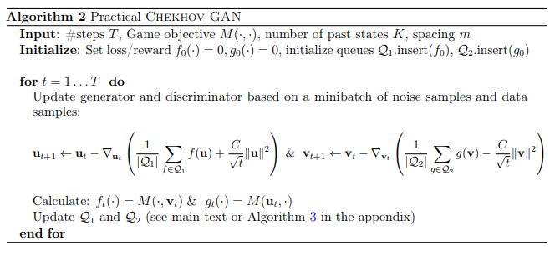
Practical CHEKHOV GAN Algorithm
What makes this different from a standard GAN training approach?
The usage of FTRL objectives for both players
Updating the weights based on the gradients of the FTRL objective
Standard GAN training only employs the gradient of the last loss/reward function
A full FTRL algorithm requires the saving of the entire history of past generators/discriminators
This is computationally intractable, thus they found it sufficient to maintain a summary of the history using a small number of representatives
More information on this process and a detailed description of the full algorithm can be found in the paper itself
Notes:
In order to capture a diverse subset of the history, we keep a queue Q containing K := |Q| models whose spacing between each other is determined by the following heuristic. Every m update steps, we remove the oldest model in the queue and add the current one. The number of steps between switches, m, can be set as a constant, but we find it more effective to keep it small at the beginning and increase its value as the number of rounds increases. We hypothesize that as the training progresses and the individual models become more powerful, we should switch the models at a lower rate, keeping them more spaced out.

Slide 16
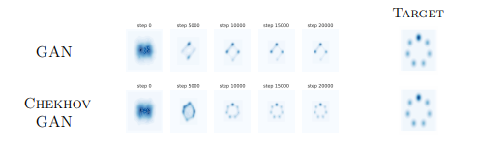
Experimental Results
Authors tested their methods on models where the traditional GAN training has difficulty converging, experiences mode dropping, among other issues
First trained a simple architecture using the standard GAN approach as well as the CHEKHOV GAN on a synthesized 2D dataset
Consists of a mixture of 7 Gaussians whose centers are aligned in a circle
Looking at the results, it can directly be seen how the traditional GAN updates lead to mode dropping
A collapse of large volumes of probability mass onto a few modes (hypothesised to be due to the differences of the minimax and maximin solutions of the game)
CHEKHOV GAN takes advantage of the history of the player’s actions, which tends to yield better results
The generator is updated such that it fools the past discriminators; in order to do so, the generator has to spread its mass more fairly according to the true data distribution
Notes:
Model dropping happens when the generator is having trouble learning some of the details from the evaluator. So, in order to 'learn' these details, the correction makes the nodes weights from the generator to drop close to 0 in order learn these details, while the overall generated image quality is greatly reduced.

Slide 17
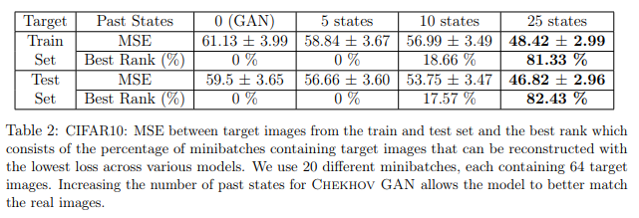
Image Modeling
Task of generating rich image data for which the modes of the data distribution are unknown
Trained a Deep Convolutional GAN (DCGAN) architecture and evaluated the performance of each model using a technique of inference via optimization (introduced by Metz et al. (2016) [4])
The average MSE over 10 rounds using different seeds is reported below
It can be seen that using CHEKHOV GAN, with as few as 5 past states, results in significant gains
These are further improved by increasing the number of past states up to 25
The training procedure also becomes more stable as seen by the decrease in the standard deviation

Slide 18
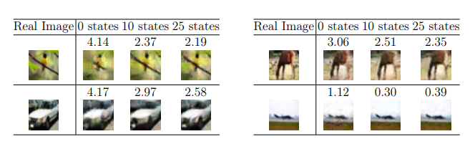
Image Modeling
Selected random images from the batch which had the largest absolute difference in MSE between GAN and CHEKHOV GAN (with 25 states)
The samples obtained from the original GAN are often more blurry, while the CHEKHOV GAN samples are both sharper and exhibit more variety (suggesting a better coverage of the true data distribution)
The reconstruction MSE loss is indicated above each image

Slide 19
Conclusion
This paper presents a principled approach to training GANs that is almost guaranteed to reach convergence to a mixed equilibrium for semi-shallow architectures
Looking at the experimental results, this approach presents several advantages over other common GAN architectures including improved stability and reductions in mode dropping
These results thus open an avenue for the use of online-learning and other game-theoretic techniques in the context of training GANs
Something that still remains open and needs further investigation is the question of whether the theoretical guarantees discussed in this paper can be extended to more complex architectures
Questions?

Slide 20
References
[1] D. P. Kingma and M. Welling. Auto-Encoding Variational Bayes. arXiv.org, Dec. 2013.
[2] D. J. Rezende, S. Mohamed, and D. Wierstra. Stochastic backpropagation and approximate inference in deep generative models. arXiv.org, 2014.
[3] I. Goodfellow, J. Pouget-Abadie, M. Mirza, B. Xu, D. Warde-Farley, S. Ozair, A. Courville, and Y. Bengio. Generative Adversarial Nets. pages 2672–2680, 2014.
[4] L. Metz, B. Poole, D. Pfau, and J. Sohl-Dickstein. Unrolled generative adversarial networks. arXiv preprint arXiv:1611.02163, 2016.

Slide 21
Additional Links
Minimax and Convex-Concave Games: https://web.stanford.edu/class/ee392o/cvxccv.pdf
Online Machine Learning: https://www.analyticsvidhya.com/blog/2015/01/introduction-online-machine-learning-simplified-2/
Mixed Strategies: https://saylordotorg.github.io/text_introduction-to-economic-analysis/s17-03-mixed-strategies.html
GANs: https://developers.google.com/machine-learning/gan/gan_structure

